Slide 1
Asymptotic Analysis
Lecture 2

Slide 2
Analytical Approach
We want a measure that is independent of the computer, programming language, and complex details of the algorithm
Usually this measure is in terms of how many times a basic operation is carried out for each value of the input size
Strategy: Running time is estimated by analyzing the primitive operations which make significant contributions to the overall algorithm time. These may broadly include:
  Comparing data items
  Computing a value
  Moving a data item
  Calling a procedure
Lecture #1
Adapted from slides by Dr Oniza

Slide 3
Algorithm Specification
Plain natural language
  High level description
Pseudo Code
  Low level to facilitate analysis and implementation
Lecture #1
Adapted from slides by Dr A. Sattar

Slide 4
Specification Using Natural Language
Preorder Tree Traversal Algorithm
  Step1. Push tree root to stack
  Step2. Pop the stack. If stack is empty exit, else process the node
  Step3. Travel down the tree following the left most path, and pushing each right child onto the stack
  Step4. When leaf node is reached, go back to step 2.
Lecture #1
Adapted from slides by Dr A. Sattar

Slide 5
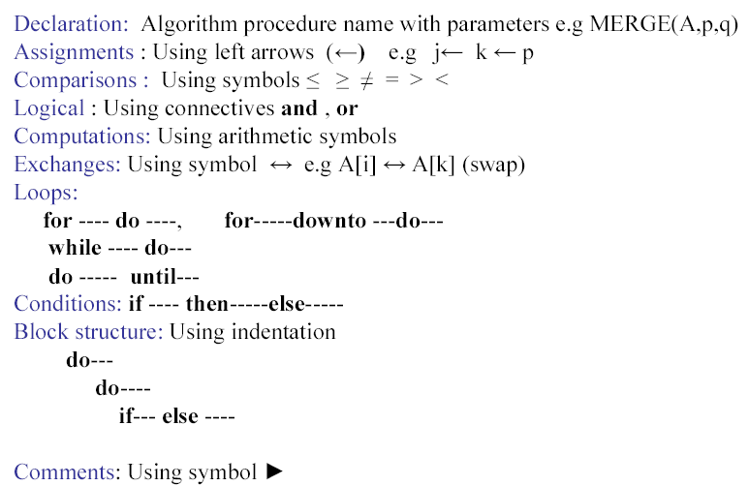
Pseudo Code Convention
Lecture #1
Adapted from slides by Dr A. Sattar

Slide 6
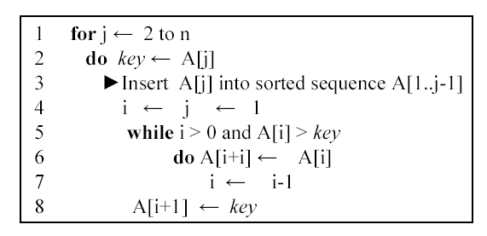
Example
Lecture #1
Adapted from slides by Dr A. Sattar

Slide 7
Algorithm Design
There are many approaches to designing algorithms:
  Divide-and-Conquer
  Greedy
  Dynamic Programming
  Brute Force
  Approximation
Each has certain advantages and limitations
Lecture #1
Adapted from slides by Dr A. Sattar

Slide 8
Complexity Analysis
It is traditional to describe the running time of a program as a function of the size of the input
For example, in a sorting problem, the input size is the number of items n in array
Input size can also contain more than one parameter e.g. for a graph
The running time of an algorithm on a particular input is the number of primitive operations or steps executed
The notion of step should be taken in a machine-independent way
As an example, take the pseudo code for an algorithm that finds the maximum element in an array of size n
Lecture #2
Adapted from slides by Dr A. Sattar

Slide 9
Case Study
Problem
  Develop an algorithm to find maximum element in an array of size n
  Analyze the algorithm for:
    Time efficiency
    Space efficiency
    Correctness
Lecture #2
Adapted from slides by Dr A. Sattar

Slide 10
Algorithm
Step #1: Store first element of the array in variable max
Step #2: Scan array to compare max with other elements
Step #3: Replace max with a larger element
Step #4: Return value held by max
Lecture #2
Adapted from slides by Dr A. Sattar

Slide 11
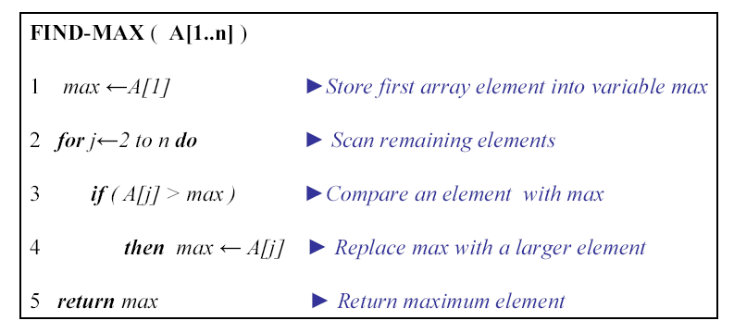
Pseudocode
The function FIND-MAX finds the maximum element in an array. The array A, of size n, is passed as argument to the function.
Lecture #2
Adapted from slides by Dr A. Sattar

Slide 12
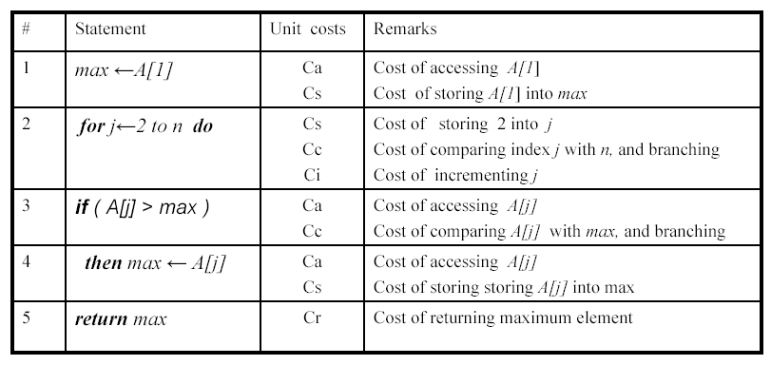
Primitive Operations
Lecture #2
Adapted from slides by Dr A. Sattar

Slide 13
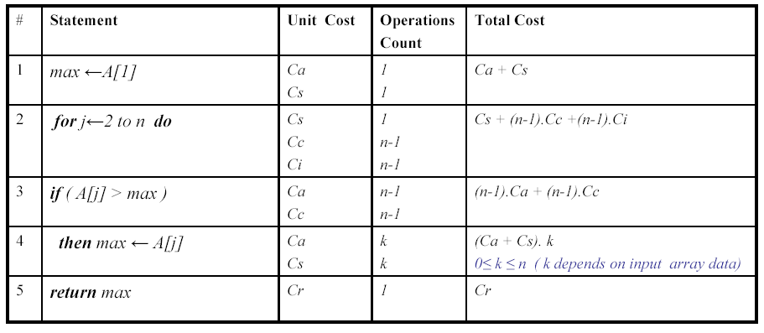

Primitive Operations (contd…)
Lecture #2
Adapted from slides by Dr A. Sattar

Slide 14
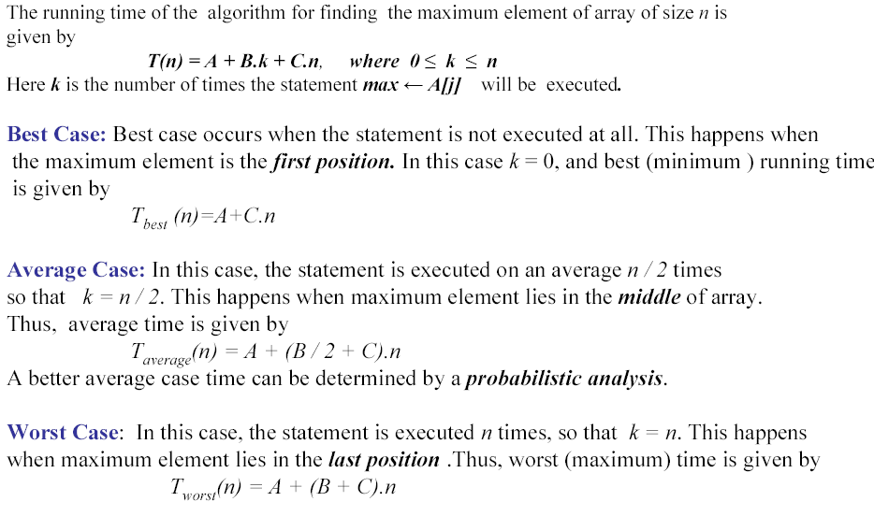
Best, Average and Worst time
Lecture #2
Adapted from slides by Dr A. Sattar

Slide 15
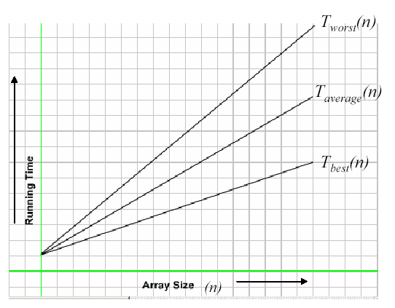
Comparison of Running Times
Lecture #2
Adapted from slides by Dr A. Sattar

Slide 16
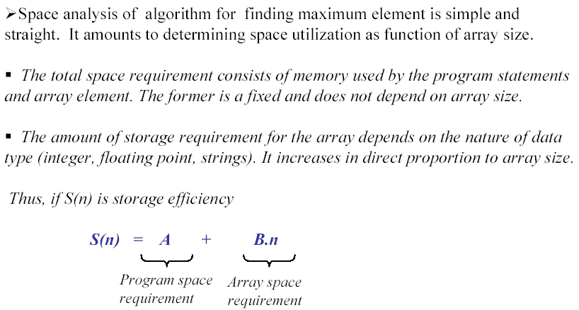
Space Efficiency
Lecture #2
Adapted from slides by Dr A. Sattar

Slide 17
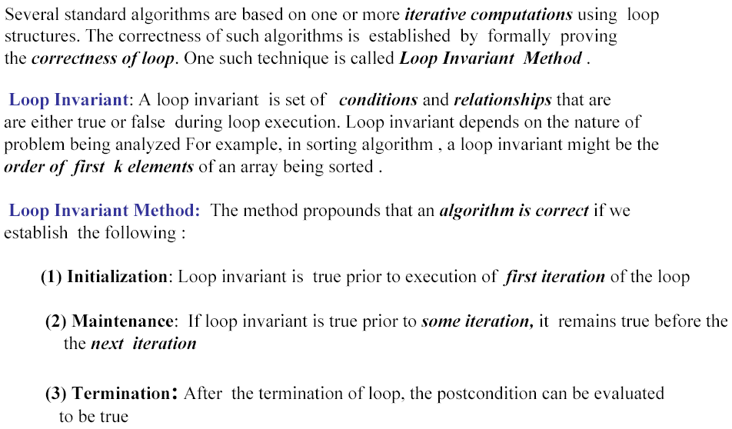
Correctness - Loop Invariant Technique
Lecture #2
Adapted from slides by Dr A. Sattar

Slide 18
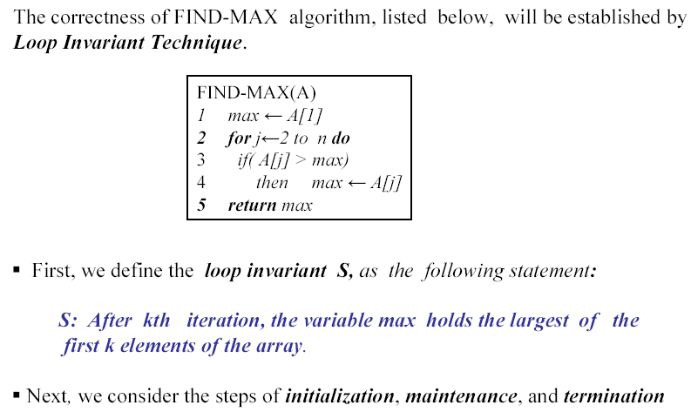
Correctness
Lecture #2
Adapted from slides by Dr A. Sattar

Slide 19
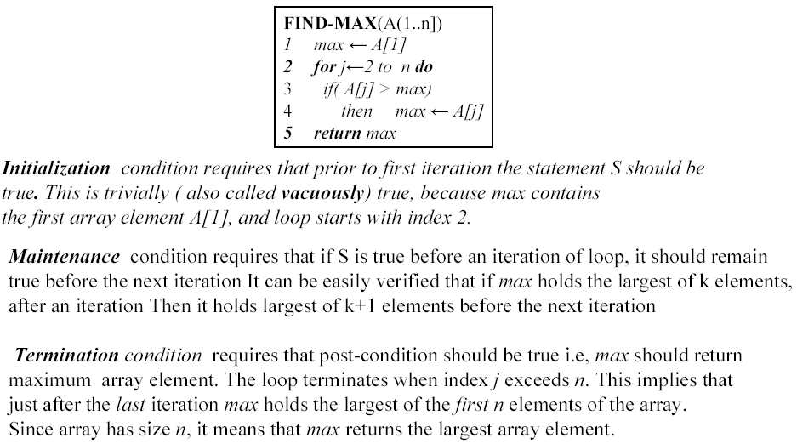
Correctness (contd…)
before
Lecture #2
Adapted from slides by Dr A. Sattar

Slide 20
Complexity Analysis
Add Array Members
ARRAY-ADD(A, n) cost times
result=0 c₁ 1
for (i=1; i<=n; i++) c₂ n+1
result=result + A[i] c₃ n
  To compute T(n), the running time of the algorithm, we sum product of cost and time column
T(n) = c₁+c₂(n+1)+c₃(n) =a+bn (where a and b are constants that depend on c_{i} )
Lecture #2
Adapted from slides by Dr A. Sattar

Slide 21
Complexity Analysis (contd…)
In the previous example, there are always n passes through the for loop no matter what the value of the numbers in the array
This is known as the Every-case running time
Consider the example of search in an array
Lecture #2
Adapted from slides by Dr A. Sattar

Slide 22
Complexity Analysis (contd…)
Search Array Members
ARRAY-SEARCH(A,n,key) cost Times
For (i=1; i<=n; i++) c₁ ?
if A[i]=key c₂ ?
return i c₃ ?
return -1 c₄ ?
  In the worst case, loop will be executed n+1 times
Worst case analysis
T(n)=a+bn
Lecture #2
Adapted from slides by Dr A. Sattar

Slide 23
Complexity Analysis (contd…)
It may interest us to know how an algorithm performs on an average
It is more difficult to analyze the average case than the worst case
To compute average case complexity, we need to assign probabilities
In case of linear search, equal probabilities are assigned to all array slots i.e. the key is equally likely in any array slot
Assuming that key has equal probability 1/n of being in any position, and unit cost is c, the average running time is given by
1c.1/n+2c.1/n+3c.1/n+….+nc.1/n=c/n(1+2+….+n)=cn(n+1)/2n= c(n+1)/2
Lecture #2
Adapted from slides by Dr A. Sattar

Slide 24
Complexity Analysis (contd…)
Average case analysis
A(n)=c(n+1)/2
Best case analysis
  B(n)=1
  Worst-case and average-case analysis are done much more often than best-case analysis
Lecture #2
Adapted from slides by Dr A. Sattar

